Slide 1
Test-driven Development Using React
COURSE INTRODUCTION

Slide 2
Use TDD to write clean code that works
Work with the Jest test framework Write good tests for React
Overview
How to write React code to pass the tests

Slide 3

Meet Our Company

Slide 4


Slide 5



Slide 6





Slide 7


Slide 8

Any number of stores
Must be fast!

Slide 9


The Conversation at Store #2
James “Jimmy” McDougall
Coffee roaster, hacker, CTO
Elizabeth “Betty” Hawkins
Professional front-end developer, coffee connoisseur

Slide 10



The Conversation at Store #2

Slide 11

The Conversation at Store #2

Slide 12
The Conversation at Store #2
What do you like about Wired Brain?

Slide 13
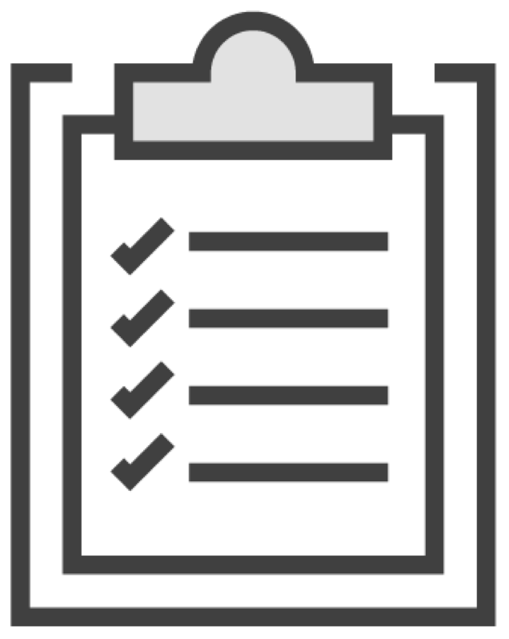
The Conversation at Store #2

Slide 14
The Conversation at Store #2
"I make quality coffee. How can I make a quality widget?"

Slide 15
The Conversation at Store #2
"Will React make a quality widget?
No. But, testing will.

Slide 16
The Conversation at Store #2
"I make quality coffee."
"If you want quality code, test it."

Slide 17

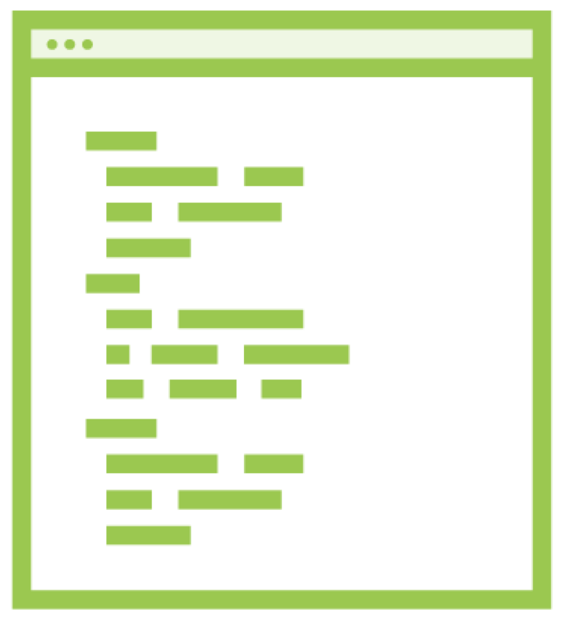
The Conversation at Store #2
Aroma Body Flavor Aftertaste
Well structured Maintainable Readable Reliable

Slide 18












Test-driven Development
TEST
REFACTOR
CODE

Slide 19
Display a map
Select a shop
Marker shows location
User can search Detect user location Get directions Scalable
Store Locator Requirements

Slide 20
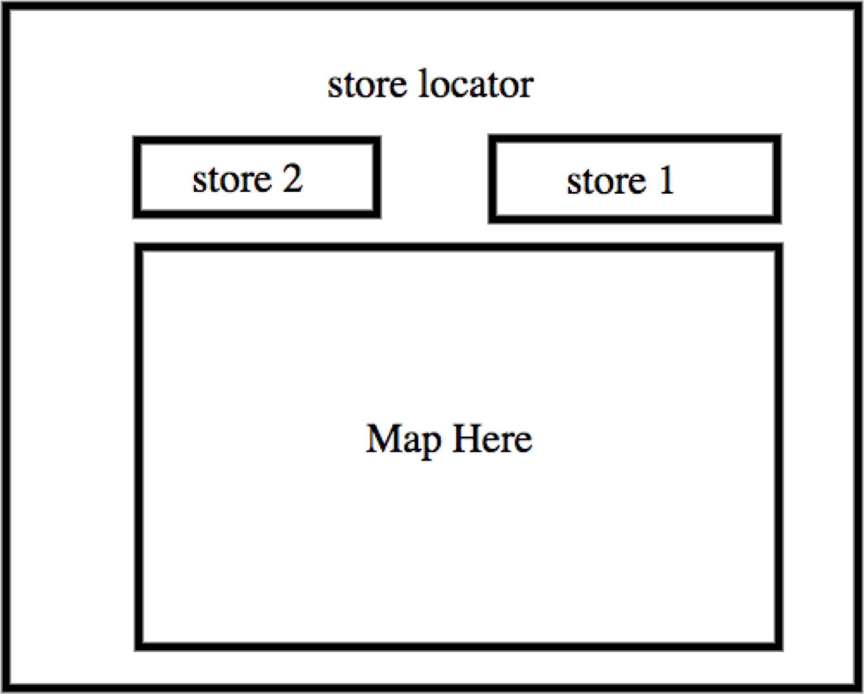
Prototype

Slide 21
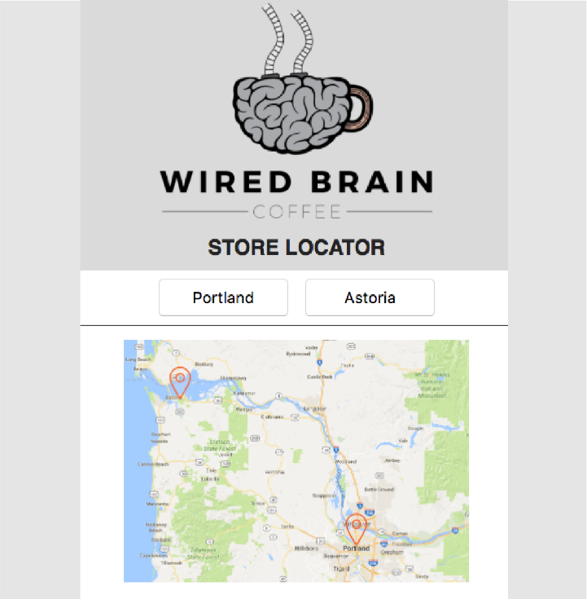
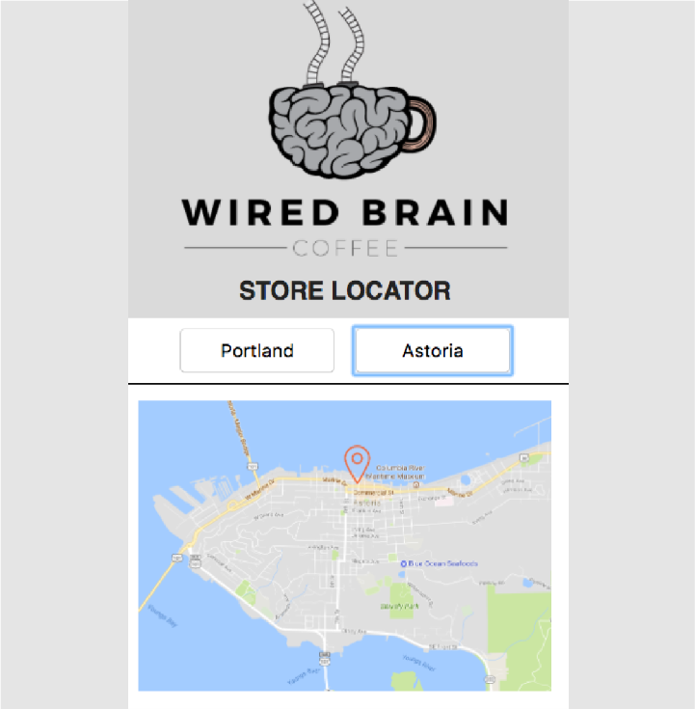
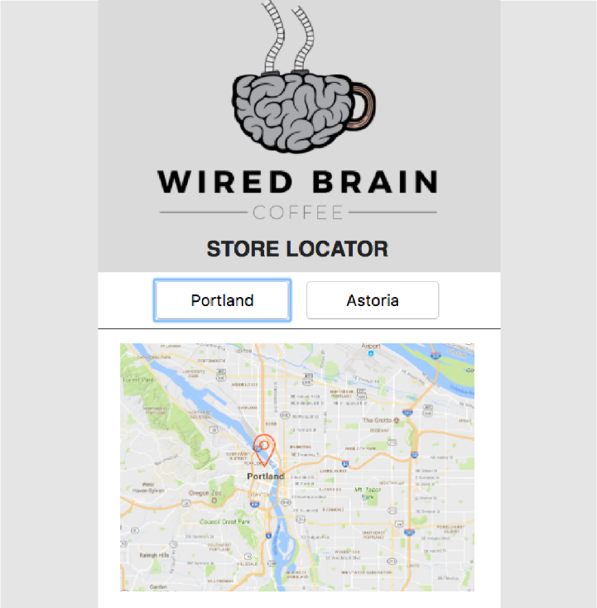
Prototype v2.0

Slide 22
Introducing TDD with React
COMING UP NEXT

